Slide 1

KURUKSHETRA 2.0​
DisruptionOps
HACKFEST 2026
• PS20
• Agentic Disaster Relief & Emergency Resource Coordinator
• Agentic Ai
• KH131
• Kala Dhua
MIT ACSC • ALANDI, PUNE

Slide 2
Kala Dhua
SLIDE 02 · PROBLEM
The Problem Is Not the Forecast. It Is the Allocation.
When a disaster hits, five zones need help at once. There are never enough boats, pumps, ambulances or teams for all five — and the picture changes every few minutes.
CITY VIEW · 09:12 · ONE HOUR INTO THE EVENT
EVERYTHING AVAILABLE, RIGHT NOW
4
Zone B
road cut · needs earthmover
23
5
Zone A
12 stranded · needs boats
units free across the whole city
4
Zone D
shelter full · needs transport
6
boats · water rescue
4
pumps · dewatering
5
ambulances · medical
3
Zone C
waterlogged · needs pumps
3
earthmovers · clearance
2
Zone E
supplies low · needs trucks
■
DEPOT
23 units free
3
trucks · supply
2
buses · evacuation
23 units. 5 simultaneous needs. Who gets what?
HOW IT IS COORDINATED TODAY
WHAT THAT COSTS
✕
Phone calls — between agencies that each hold part of the picture
↓
Duplicated effort — the same street cleared twice, the next one not at all
✕
Two units, one incident — while a third zone gets nothing at all
↓
Slow decisions — minutes lost per zone, multiplied across a city
✕
No shared availability — so nobody can optimise across the zones
↓
Misdirected units — down a road a crew already reported blocked
✕
Nothing written down — re-planned in a head, unreviewable afterwards
↓
No learning — the next disaster starts from the same blank sheet
02
MIT ACSC • ALANDI, PUNE

Slide 3
Kala Dhua
SLIDE 03 · BEFORE AND AFTER
One New Report, and Everything Re-plans
This is the demo PS20 asks for, and the single hardest thing in the problem: staying correct while the facts move.
MANUAL COORDINATION
DISRUPTIONOPS
Zone A reports 12 people stranded.
09:12
Parsed, trust-scored, clustered → severity 5. The two nearest water-rescue boats are assigned.
Officer calls fire brigade. Two boats dispatched.
09:14
Already done, two minutes ago.
Zone D reports a shelter at capacity.
09:19
Re-plan: a bus is re-tasked, the cost of the switch weighed first.
A second agency, unaware, also sends a boat to Zone A.
09:21
Second agency request matched to the open incident. Duplicate blocked.
Zone C reports rising water. No unit is free.
09:26
No free pump. The shortfall is raised to the officer, not hidden.
Crew radios that the Zone A road is blocked. Nobody re-plans.
09:31
Road removed from the graph. Route re-solved.
Three units on one incident. Two zones waiting. Nothing written down.
Every step recorded with the event that caused it. Re-plan: under two seconds.
03
MIT ACSC • ALANDI, PUNE

Slide 4
Kala Dhua
SLIDE 04 · SOLUTION
A Coordinator, Not a Dashboard
Agents that read every report, work out what each zone needs, solve the allocation under real constraints, and re-solve the moment anything changes.
REQ 01
REQ 02
REQ 03
REQ 04
REQ 05
Zone reporting
Resource inventory
Needs assessment
Allocation agent
Inter-agency
5 channels, 1 path
93 units, 9 kinds
capability per category
OR-Tools CP-SAT
request · accept · record
REQ 06
REQ 07
REQ 08
REQ 09
REQ 10
Dynamic re-allocation
Severity scoring
Duplicate detection
Console + Copilot
Audit log
with switching cost
corroboration-lifted
reports and dispatch
15 screens · 19 tools
database-enforced
All ten core requirements are demonstrable on the deployed system.
WHAT MAKES IT DIFFERENT
— The model never produces a number. Needs come from the taxonomy, allocation from the solver, authority from a cited clause. Remove the AI entirely and the system still runs — no competitor demo can say that.
— Re-planning carries a switching cost, so crews are re-tasked only when the gain beats the disruption. That is the difference between re-allocation and thrashing.
— One hazard-agnostic contract: flood, heat, air, fire and seismic share one codebase. A new disaster type is configuration, not a new product.
04
MIT ACSC • ALANDI, PUNE

Slide 5
Kala Dhua
SLIDE 05 · COMPETITOR ANALYSIS
Where Everyone Else Stops
Nobody here is bad at their job. Each solves one slice of PS20, and the slices do not meet.
Reports from zones
Models needs
Allocates units
Re-allocates live
Detects duplicates
Audit trail
IMD / CWC / NDMA
forecast agencies
●
—
—
—
—
—
Sachet / CAP alerting
broadcast
●
—
—
—
—
—
Everbridge / Esri EOC
commercial suites
●
●
—
—
—
●
Spreadsheets + phone
what is used today
●
—
●
—
—
—
DisruptionOps
this system
●
●
●
●
●
●
Against nearest-first, five seeds at a third of the fleet: 7% fewer demands uncovered, 4.2 min to commit a unit against 10.7.
05
MIT ACSC • ALANDI, PUNE

Slide 6
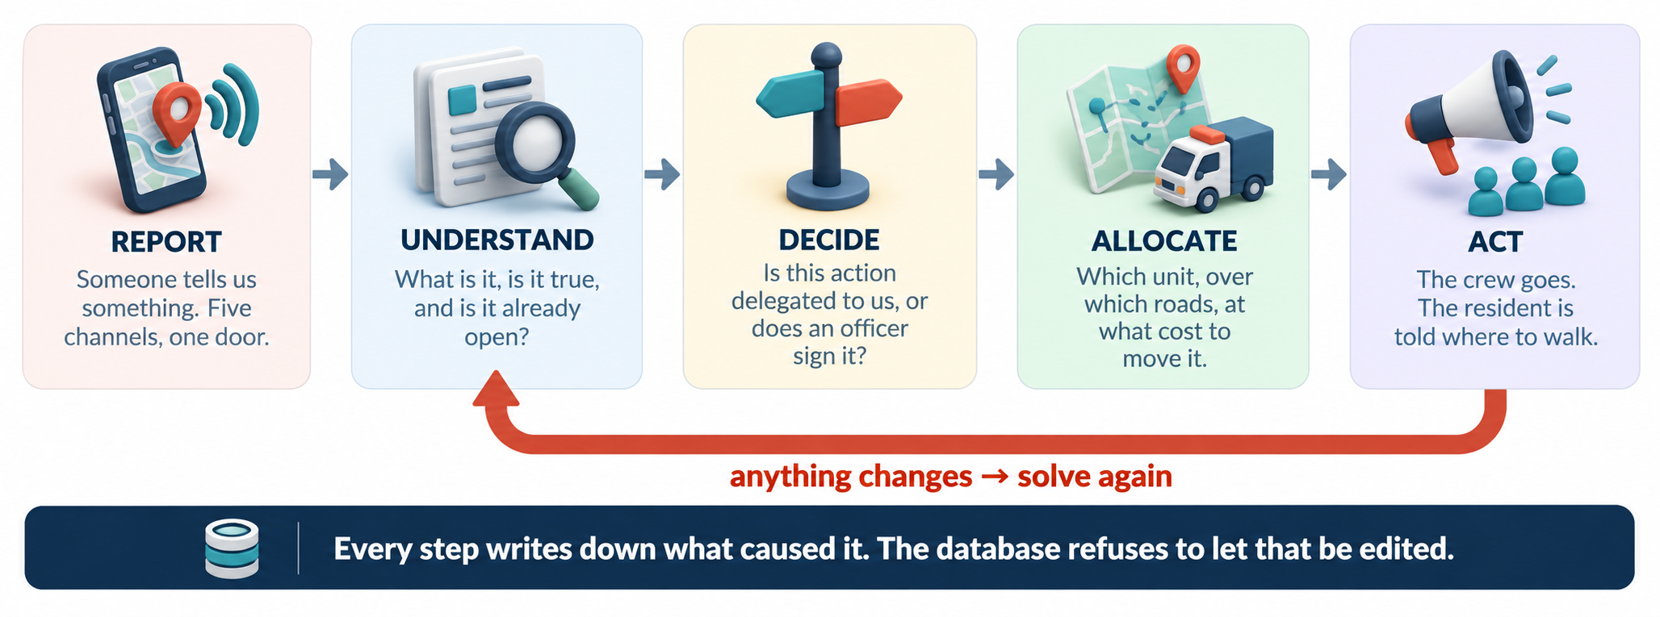
How It Is Built
SLIDE 06 · TECHNICAL APPROACH
A report enters at the top and a crew is moving at the bottom. Every step writes down why, and the two arrows back into the solver are what make it a loop.

Slide 7
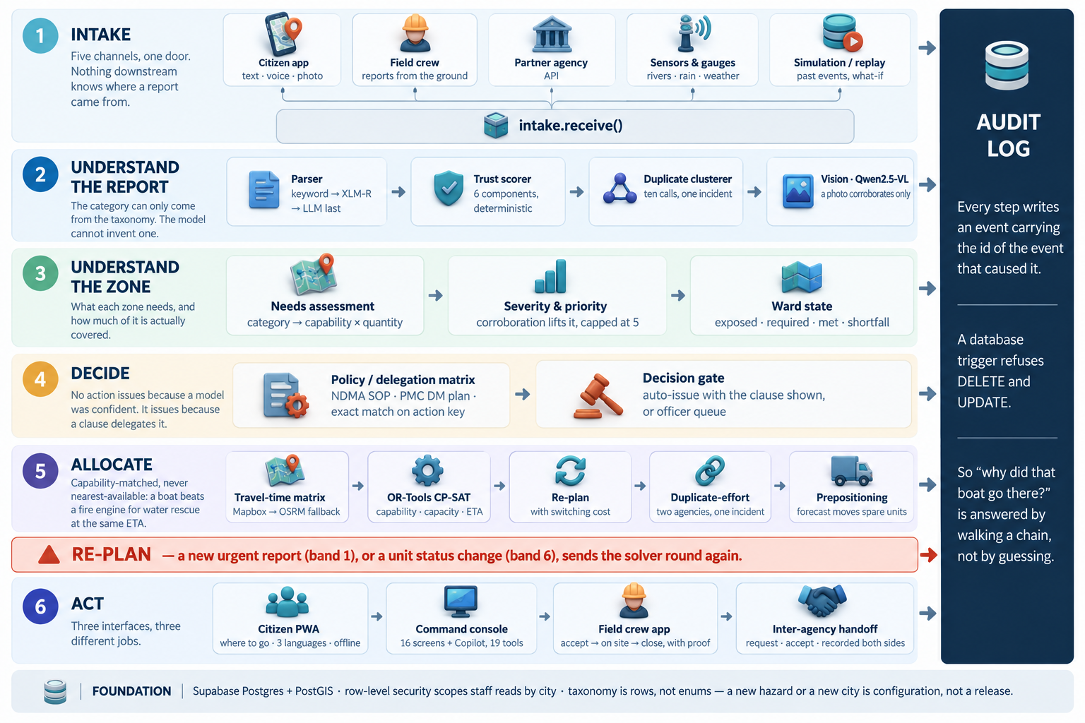
How It Is Built Detailed
SLIDE 06 · TECHNICAL APPROACH
A report enters at the top and a crew is moving at the bottom. Every step writes down why, and the two arrows back into the solver are what make it a loop.

Slide 8
Kala Dhua
SLIDE 07 · FEASIBILITY & IMPACT
Measured Impact, and Why We Trust It
-27%
4.2 min
10 / 10
fewer demands left uncovered than nearest-first
to commit a unit — against 10.7 done by hand
PS20 requirements demonstrable on the deployed system
TIME TO COMMIT A UNIT · MINUTES, FROM ZERO, LOWER IS BETTER
WHAT THE BETTER PLAN COSTS
Nearest-first
10.7
arrival p90
DisruptionOps
+27% covered, +9% p90
DisruptionOps
4.2
nearest-first
0
4
8
12
demands covered →
Same incident stream, five random seeds, one third of the fleet.
Re-tasking a committed crew is never free. The switch is priced first.
We pay 9% on the slowest arrivals to leave 7% fewer demands uncovered — a trade we chose, measured, and can show.
WHY WE TRUST THESE NUMBERS
The benchmark harness is in the repo — same seeds, same fleet, anyone can re-run it.
Learned: Gamma-Poisson recurrence per zone · XLM-RoBERTa zero-shot for report text · Qwen2.5-VL for photos · GloFAS v4.
Deterministic on purpose: trust scoring, clustering, the gate and the allocator. No model ever produces a number.
07
MIT ACSC • ALANDI, PUNE

Slide 9
Kala Dhua
SLIDE 08 · WHY IT IS AGENTIC
Why This Is Actually Agentic
Not a chatbot with buttons. A loop that starts itself, acts inside the authority it can cite, and changes because of what happened last time.
✎
≡
▣
→
◎
SENSE
UNDERSTAND
DECIDE
ACT
OBSERVE
Six channels, one door. Reports arrive without anyone asking.
Parse, trust-score, cluster. Ten calls about one street become one incident.
Checked against a delegation clause. Inside authority, it issues itself.
The solver assigns, crews are tasked, routes avoid roads reported blocked.
Was the unit used? Did the shortfall close? Every outcome is written down.
LEARN — the recurrence, the reporter reliability scores and the prepositioning hit-rate all move with what actually happened
↻
IT STARTS ITSELF
▣
IT IS ALLOWED TO ACT
↑
IT GETS BETTER
Nothing here waits for a prompt. A report landing, a crew calling a road blocked, or a forecast crossing a threshold each set the loop running on their own.
Inside a cited delegation clause the decision issues with no human. Outside it, it stops and asks. Authority is the gate — never model confidence.
Prepositioning proposals are scored against whether the unit was actually used. A capability that keeps being wrong drifts down until a human has to agree.
REFERENCES : NDMA Guidelines on Management of Urban Flooding (2010) · PMC Disaster Management Plan · open-meteo.com · GloFAS v4 · Google OR-Tools CP-SAT · Mapbox Directions / OSRM · XLM-RoBERTa · Qwen2.5-VL
CODE github.com/officialayush23/DisruptionOps — migrations, the vision contract and the dispatch benchmark harness are all public.
08
MIT ACSC • ALANDI, PUNE

Slide 10
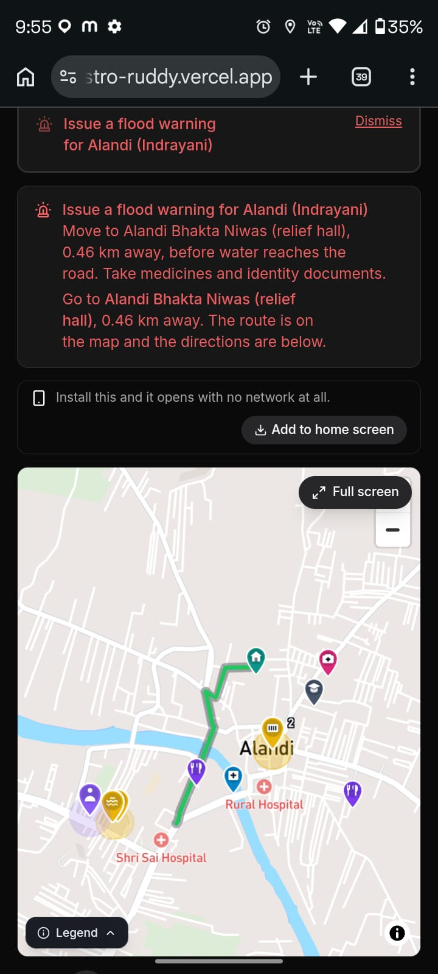
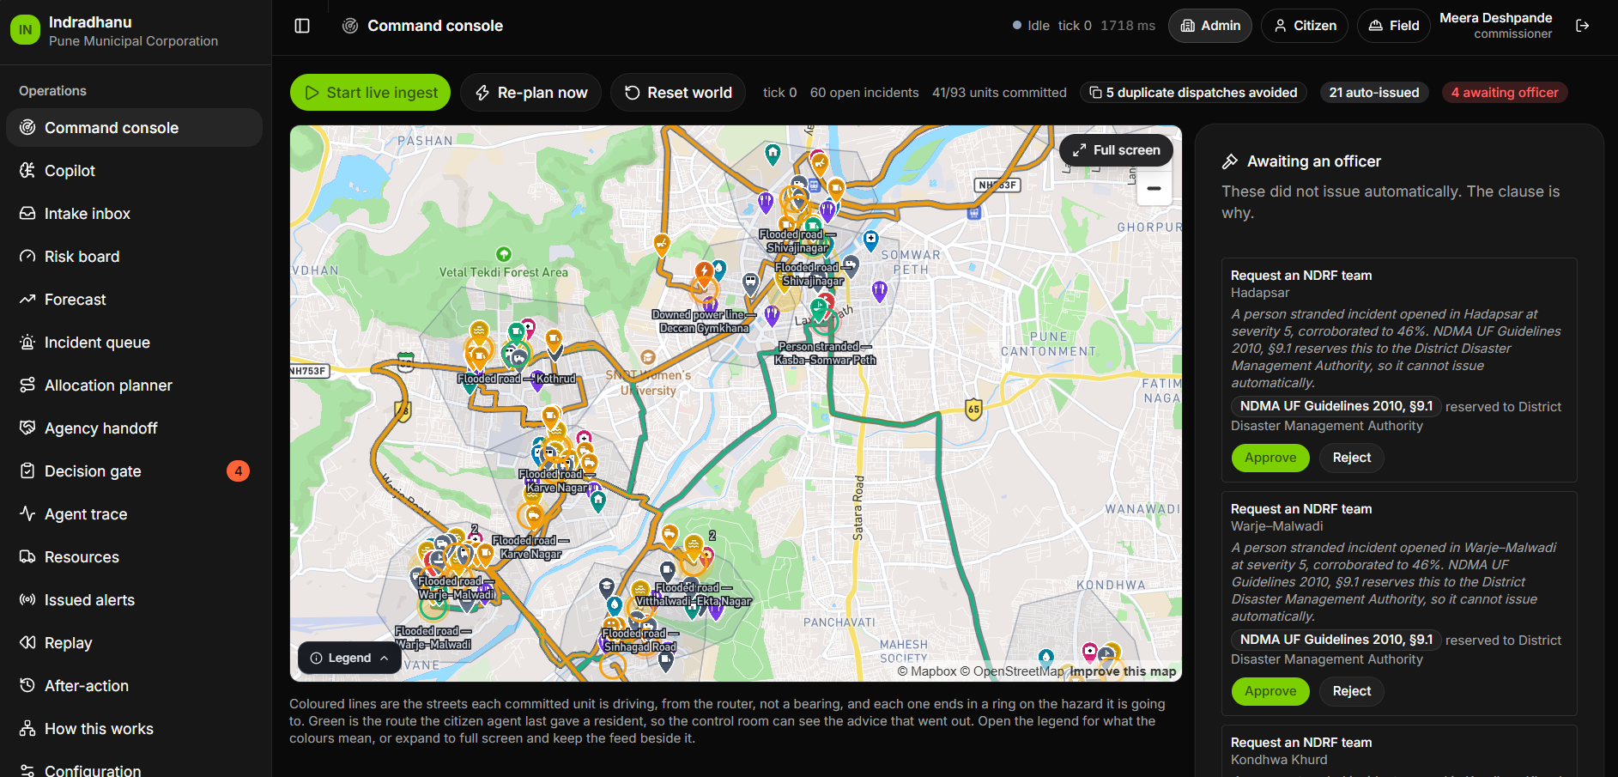
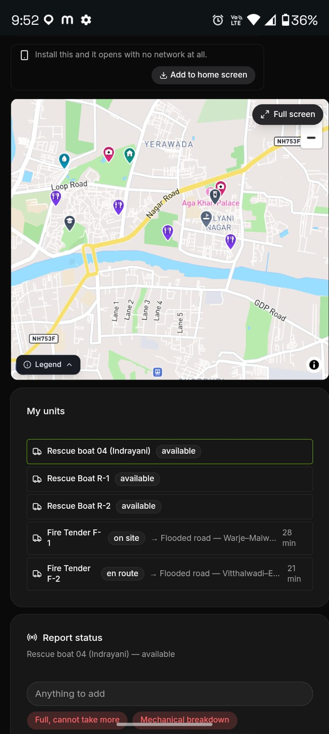
Kala Dhua
SLIDE 09 · BUILT WITH
Three Surfaces, One Shared Picture
The same state, drawn for the person who needs it: a resident, a commander, a crew.
DisruptionOps · Command Console
TASK 4412 · ZONE A
12 people stranded
boat · water rescue · sev 5
✓
Route avoids the blocked road
◔
ETA 6 min · 1.8 km
✎
Close with a photo as proof
REPORT · VOICE
ACCEPT
ON SITE
CITIZEN PWA
voice · photo · live route · 3 languages · offline outbox
COMMAND CONSOLE
16 screens · risk board · allocation planner · delegation gate · Copilot with 19 tools
FIELD CREW APP
accept → on site → close, with proof
✦
THE SOLVER
■
RELIEF LOGISTICS
◆
BUILT WITH
OR-Tools CP-SAT, re-run as the world moves — capability match · switching cost · duplicate-effort detection
78 facilities with stock and occupancy modelled; a full shelter raises an incident like any other
React · FastAPI · Supabase Postgres + PostGIS · Gemini · XLM-R · Qwen2.5-VL — prose, never a decision
09
MIT ACSC • ALANDI, PUNE

Slide 11
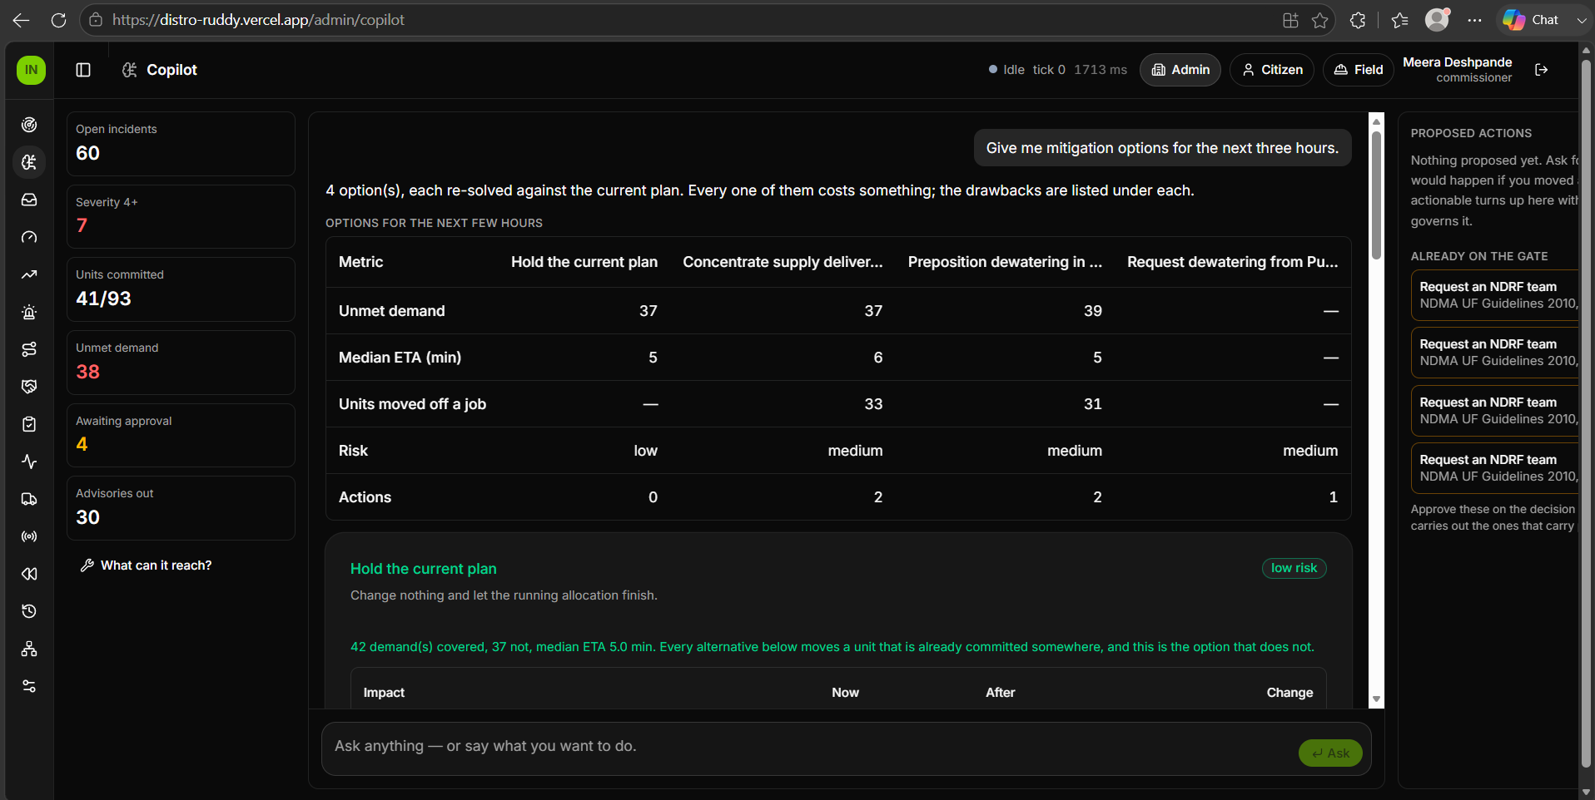
Kala Dhua
SLIDE 10 · DEMO
See It Running
LIVE DEMO https://distro-ruddy.vercel.app/citizen
CODE github.com/officialayush23/DisruptionOps
Open /citizen — no login. Five zones, live severity, and the route redraws as roads close. Sign in for the command console and the crew app.
✦
COPILOT · 19 TOOLS · READ / ANALYSE / ACT
◆
WHAT-IF · PUMP 3 → BANER
“What are my options for the next three hours?”
NOW
IF APPLIED
Demands uncovered
3
2
THREE STRATEGIES, EACH PRICED BY THE SOLVER
A Worst ward first — 2 demands uncovered, p90 31 min
B Balance across five wards — 1 uncovered, p90 38 min
C Hold two boats in reserve — 3 uncovered, p90 27 min
Baner shortfall
1.0 pump
0
Kothrud cover
1 pump
none
Arrival p90
29 min
33 min
Units re-tasked
—
1
“What if I move Pump 3 to Baner?”
!
THE HOLE IT LEAVES
Kothrud has no pump for 40 minutes. Said before you decide, not after.
Re-solved on a copy. Baner's shortfall closes — Kothrud loses its only pump. See the panel.
Apply the second one.
→
▣
APPLY → DELEGATION GATE
PMC DMP 2023 cl. 6.1 · auto-issues, and the clause is shown
19 tools, three tiers: read, analyse, act. Only the last one may change the world.
10
MIT ACSC • ALANDI, PUNE

